Slide 1
Romanesque Sculpture

Slide 2
Introduction:
Following early Christian sculpture, the first European-wide architectural style was Romanesque architecture, which properly emerged during the period 1000-1200.
The slow maturing that culminated in the advent of monumental sculpture had taken place throughout the 11th century in the Benedictine monasteries of France. The reform of the Church, that attempt to purify the men of prayer and, by freeing them from the defilement which kept them at a remove from holiness, to fit them to fulfil their social function better, had actually begun with the monastic institution. This enabled the latter to capture the fervour of the faithful, attract the growing flood of pious donations, and create suitably inspirational Christian art to illustrate the message of the Bible.

Slide 3
Romanesque art is the art of Europe from approximately 1000 AD to the rise of the Gothic style in the 13th century, or later, depending on region.
The preceding period is known as the Pre-Romanesque period.
The term was invented by 19th-century art historians, especially for Romanesque architecture, which retained many basic features of Roman architectural style – most notably round-headed arches, but also barrel vaults, apses, and acanthus-leaf decoration – but had also developed many very different characteristics.
In Southern France, Spain and Italy there was an architectural continuity with the Late Antique, but the Romanesque style was the first style to spread across the whole of Catholic Europe, from Sicily to Scandinavia.
Romanesque art was also greatly influenced by Byzantine art, especially in painting, and by the anti-classical energy of the decoration of the Insular art of the British Isles.
From these elements was forged a highly innovative and coherent style

Slide 5
Most Romanesque sculpture is pictorial and Biblical in subject.
A great variety of themes are found on capitals and include scenes of Creation and the Fall of Man, episodes from the life of Christ and those Old Testament scenes which prefigure his Death and Resurrection, such as Jonah and the Whale and Daniel in the lions' den.
Many Nativity scenes occur, the theme of the Three Kings being particularly popular.
The cloisters of Santo Domingo de Silos Abbey in Northern Spain, and Moissac are fine examples surviving complete.
A feature of some Romanesque churches is the extensive sculptural scheme which covers the area surrounding the portal or, in some case, much of the facade.
Angouleme Cathedral in France has a highly elaborate scheme of sculpture set within the broad niches created by the arcading of the facade.
In Catalonia, an elaborate pictorial scheme in low relief surrounds the door of the church of Santa Maria at Ripoll

Slide 6
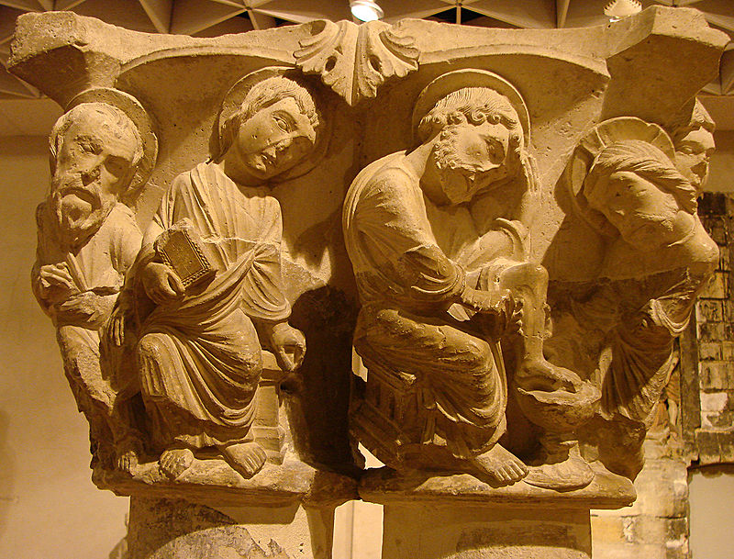
Characteristics
Three main characteristics of Romanesque sculpture are as follow:
Thin and elongated figures.
Abstract designs.
Human-like features.

Slide 7
Other Romanesque sculpture characteristics include:
Faces that look more realistic and soft, which contrasts with the harsh features of previous eras.
Bone structure within the faces.
Figures have some three dimensional figures and do not rely on resting into the walls.
The drapery surrounding figures begins to look more realistic and soft than previous eras.
Subject matters start to tell stories. For example, they may represent the kings of France as descendants of the kings, queens and prophets in the Bible.

Slide 8
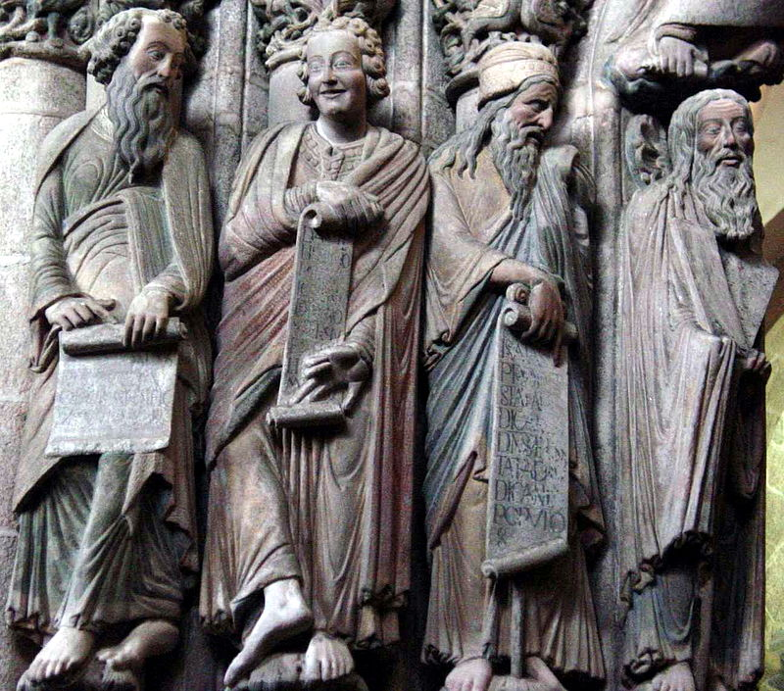
The purpose of the sculptural schemes was to convey a message that the Christian believer should recognize wrongdoing, repent and be redeemed. The Last Judgement reminds the believer to repent. The carved or painted Crucifix, displayed prominently within the church, reminds the sinner of redemption.

Slide 9
Examples
life-size wooden Crucifix commissioned by Archbishop Gero of Cologne
Cahors Cathedral

Slide 10
life-size wooden Crucifix commissioned by Archbishop Gero of Cologne
The best-known surviving large sculptural work of Proto-Romanesque Europe is the life-size wooden Crucifix commissioned by Archbishop Gero of Cologne in about 960–65, apparently the prototype of what became a popular form. These were later set up on a beam below the chancel arch, known in English as a rood, from the twelfth century accompanied by figures of the Virgin Mary and John the Evangelist to the sides.[2] During the 11th and 12th centuries, figurative sculpture strongly revived, and architectural reliefs are a hallmark of the later Romanesque period.

Slide 12
The Gero Cross or Gero Crucifix ("Gero-Kreuz" in German), of around 965–970, is the oldest large sculpture of the crucified Christ north of the Alps, and has always been displayed in Cologne Cathedral in Germany. It was commissioned by Gero, Archbishop of Cologne, who died in 976, thus providing a terminus ante quem for the work. It is carved in oak, and painted and partially gilded – both have been renewed. The halo and cross-pieces are original, but the Baroque surround was added in 1683. The figure is 187 cm high, and the span of the arms is 165 cm.
The Gero Cross is important to medieval art for the unique way it depicts Christ. The figure appears to be the earliest, and finest, of a number of life-size German wood sculpted crucifixions that appeared in the late Ottonian or early Romanesque period, later spreading to much of Europe. It is the first monumental depiction of the crucified Christ on the Cross and the first monumental sculpture dating from this period.[2] Standing over six feet tall, it was one of the largest crosses of its time.

Slide 13
Cahors Cathedral
Cahors Cathedral (Cathédrale Saint-Étienne de Cahors) is a Roman Catholic cathedral and a national monument of France in the town of Cahors, Midi-Pyrénées. It is an impressive example of the transition between late Romanesque architecture and the Gothic.
The façade, renovated in 1316–1324 by Guillaume de Labroue, cousin of Pope John XXII, confirms this impression: it resembles a heavy castle wall, consisting in a porch surmounted by a bell tower enclosed between two towers. The six windows, as well as those on the porch sides, are rather narrow; the only elements characterizing it as a church are the magnificent portal with triple splays, surmounted by a gallery of small arches, and the large rose window.
In Gothic style on a Romanesque base (to which belong the columns with decorated capitals), the apse has three chapels with sculptures. The complex forms a pleasant contrast between the white apse and the colorful stained glass and the paintings of the choir.

Slide 19
